Slide 1

应用层、底层、上位机描述
BMS 概述

Slide 2
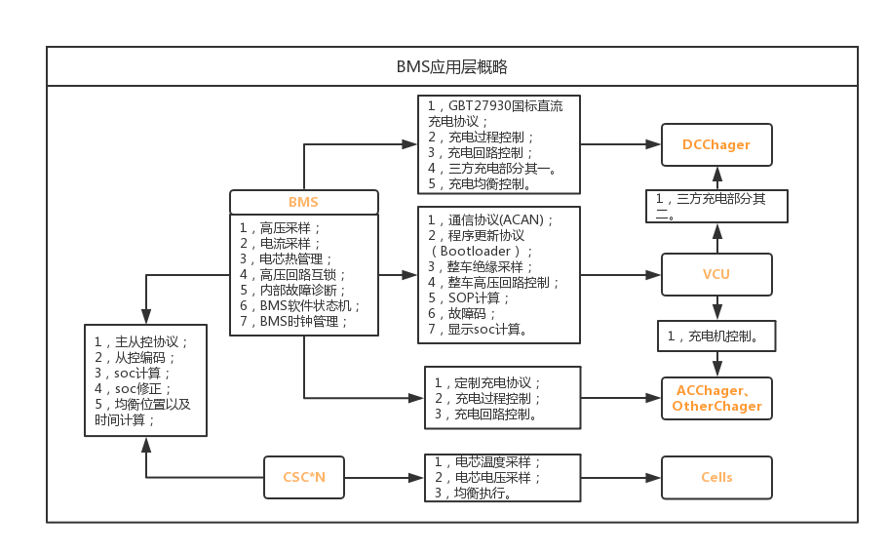

Slide 3
BMS底层和硬件概述

Slide 4
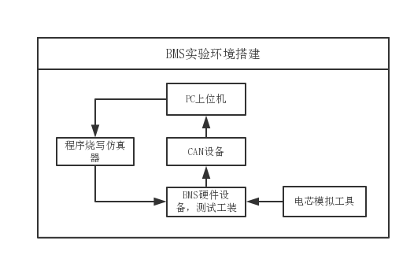
BMS实验环境搭建：
1，PC上位机需要在PC端进行开发，颗采用labview、vb、c#等开发；
2，CAN设备需要ZLGCAN或ValueCAN等；
3，测试工装需要自行设计搭建，主要用于将BMS中的信号线引出，在外部进行输入、控制、模拟等；
4，电芯模拟工具需要额外购买，精度要在1mV以上；

Slide 5
人员需求
CLICK HERE TO ADD YOUR CONTENTS ABOUT THIS PART
02
YOUR
CONTENTS
CLICK HERE TO ADD YOUR CONTENTS ABOUT THIS PART
CLICK HERE TO ADD YOUR CONTENTS ABOUT THIS PART
03
YOUR
CONTENTS
04
YOUR
CONTENTS

Slide 6

SUBTITLE IN HERE
CLICK HERE TO ADD YOUR TITLE
SUBTITL IN HERE
YOUR CONTENTS
CLICK HERE TO ADD YOUR CONTENTS
CLICK HERE TO ADD YOUR CONTENTS
78%
CLICK HERE TO ADD YOUR CONTENTS

Slide 7
SUBTITLE IN HERE
CLICK HERE TO ADD YOUR TITLE
SUBTITLE
CLICK ADD YOUR CONTENTS
SUBTITLE
CLICK ADD YOUR CONTENTS
SUBTITLE
CLICK ADD YOUR CONTENTS
SUBTITLE
CLICK ADD YOUR CONTENTS
SUBTITLE
CLICK ADD YOUR CONTENTS

Slide 8
SUBTITLE IN HERE
CLICK HERE TO ADD YOUR TITLE
01
CLICK HERE TO ADD YOUR DESCRIPTION SENTENCES ABOUT THIS PART
03
CLICK HERE TO ADD YOUR DESCRIPTION SENTENCES ABOUT THIS PART
02
CLICK HERE TO ADD YOUR DESCRIPTION SENTENCES ABOUT THIS PART
04
CLICK HERE TO ADD YOUR DESCRIPTION SENTENCES ABOUT THIS PART

Slide 9


PART 02 CLICK HERE TO ADD YOUR TITLE
THIS IS A SUMMARY PART. CLICK TO ADD YOUR DESCRIPTION SENTENCES ABOUT THIS PART IN HERETHIS IS A SUMMARY PART.

Slide 10
SUBTITLE IN HERE
CLICK HERE TO ADD YOUR TITLE
SUBTITLE IN HERE
CLICK HERE TO ADD YOUR DESCRIPTION SENTENCES ABOUT THIS PART
1
CLICK HERE TO ADD YOUR DESCRIPTION SENTENCES
CLICK HERE TO ADD YOUR DESCRIPTION SENTENCES
CONTENTS
SUBTITLE IN HERE
CLICK HERE TO ADD YOUR DESCRIPTION SENTENCES ABOUT THIS PART
CONTENTS
2
SUBTITLE IN HERE
CLICK HERE TO ADD YOUR DESCRIPTION SENTENCES ABOUT THIS PART
CONTENTS
4
CLICK HERE TO ADD YOUR DESCRIPTION SENTENCES
CONTENTS
CLICK HERE TO ADD YOUR DESCRIPTION SENTENCES
SUBTITLE IN HERE
CLICK HERE TO ADD YOUR DESCRIPTION SENTENCES ABOUT THIS PART
3

Slide 11






SUBTITLE IN HERE
CLICK HERE TO ADD YOUR TITLE
THIS SI A SUMMARY PART. CLICK HERE TO ADD YOUR DESCRIPTION SENTENCES ABOUT THIS PART.
“
THIS SI A SUMMARY PART. CLICK HERE TO ADD YOUR DESCRIPTION SENTENCES ABOUT THIS PART. THIS SI A SUMMARY PART. CLICK HERE TO ADD YOUR DESCRIPTION SENTENCES ABOUT THIS PART.
CLICK HERE TO ADD YOUR DESCRIPTION SENTENCES
CLICK HERE TO ADD YOUR DESCRIPTION SENTENCES
CLICK HERE TO ADD YOUR DESCRIPTION SENTENCES
CLICK HERE TO ADD YOUR DESCRIPTION SENTENCES
CLICK HERE TO ADD YOUR DESCRIPTION SENTENCES
CLICK HERE TO ADD YOUR DESCRIPTION SENTENCES

Slide 12
SUBTITLE IN HERE
CLICK HERE TO ADD YOUR TITLE
XX%
XX%
SUBTITLE IN HERE
CLICK HERE TO ADD YOUR DESCRIPTION SENTENCES ABOUT THIS PART
SUBTITLE IN HERE
CLICK HERE TO ADD YOUR DESCRIPTION SENTENCES ABOUT THIS PART

Slide 13
SUBTITLE IN HERE
CLICK HERE TO ADD YOUR TITLE
TITLE
HERE
TEXT
HERE
TEXT
HERE
TEXT
HERE
TEXT
HERE
TEXT
HERE
THIS IS A SUMMARY PART. CLICK HERE TO ADD YOUR DESCRIPTION SENTENCES ABOUT THIS PART

Slide 14


PART 03 CLICK HERE TO ADD YOUR TITLE
THIS IS A SUMMARY PART. CLICK TO ADD YOUR DESCRIPTION SENTENCES ABOUT THIS PART IN HERETHIS IS A SUMMARY PART.

Slide 15
SUBTITLE IN HERE
CLICK HERE TO ADD YOUR TITLE
THIS IS A SUMMARY PART. CLICK HERE TO ADD YOUR DESCRIPTION SENTENCES ABOUT THIS PART
TEXT HERE
TEXT HERE
TEXT HERE
TEXT HERE
CONTENTS HERE
CONTENTS HERE
CONTENTS HERE
CONTENTS HERE
CONTENTS HERE
CONTENTS HERE
CONTENTS HERE
CONTENTS HERE
CONTENTS HERE
CONTENTS HERE
CONTENTS HERE
CONTENTS HERE
CONTENTS HERE
CONTENTS HERE
CONTENTS HERE
CONTENTS HERE

Slide 16











SUBTITLE
CLICK HERE TO ADD YOU DESCRIPTION SENTENCES ABOUT THIS PART.
“
THIS SI A SUMMARY PART. CLICK HERE TO ADD YOUR DESCRIPTION SENTENCES ABOUT THIS PART. THIS SI A SUMMARY PART. CLICK HERE TO ADD YOUR DESCRIPTION SENTENCES ABOUT THIS PART.

Slide 17
SUBTITLE IN HERE
CLICK HERE TO ADD YOUR TITLE
TEXT
ADD YOUR SUBTITLE IN HERE
CLICK HERE TO ADD YOUR DESCRIPTION SENTENCES ABOUT THIS PART
TEXT
ADD YOUR SUBTITLE IN HERE
CLICK HERE TO ADD YOUR DESCRIPTION SENTENCES ABOUT THIS PART
TEXT
ADD YOUR SUBTITLE IN HERE
CLICK HERE TO ADD YOUR DESCRIPTION SENTENCES ABOUT THIS PART

Slide 18
SUBTITLE IN HERE
CLICK HERE TO ADD YOUR TITLE
SUBTITLE IN HERE
SUBTITLE IN HERE
SUBTITLE IN HERE
CLICK HERE TO ADD YOUR DESCRIPTION SENTENCES ABOUT THIS PART
CLICK HERE TO ADD YOUR DESCRIPTION SENTENCES ABOUT THIS PART
CLICK HERE TO ADD YOUR DESCRIPTION SENTENCES ABOUT THIS PART
YOUR TEXT IN HERE
YOUR TEXT IN HERE
YOUR TEXT IN HERE

Slide 19


PART 04 CLICK HERE TO ADD YOUR TITLE
THIS IS A SUMMARY PART. CLICK TO ADD YOUR DESCRIPTION SENTENCES ABOUT THIS PART IN HERETHIS IS A SUMMARY PART.

Slide 20
SUBTITLE IN HERE
CLICK HERE TO ADD YOUR TITLE
TEXT
CONTENTS HERE
SUBITLE IN HERE
CLICK HRER TO ADD YOUR CONTENTS HERE ABOUT THIS PAGE.
CLICK HRER TO ADD YOUR CONTENTS HERE ABOUT THIS PAGE
CLICK HRER TO ADD YOUR CONTENTS HERE ABOUT THIS PAGE
TEXT
CONTENTS HERE
TEXT
CONTENTS HERE
CLICK HRER TO ADD YOUR CONTENTS HERE ABOUT THIS PAGE

Slide 21

SUBTITLE IN HERE
CLICK HERE TO ADD YOUR TITLE
123
CLICK HERE TO ADD YOUR DESCRIPTION SENTENCES ABOUT THIS PART
THIS IS A SUMMARY PART. CLICK HERE TO ADD YOUR DESCRIPTION SENTENCES ABOUT THIS PAR. THIS IS A SUMMARY PART. CLICK HERE TO ADD YOUR DESCRIPTION SENTENCES ABOUT THIS PAR.
TEXT HERE
4
CLICK HERE TO ADD YOUR DESCRIPTION SENTENCES ABOUT THIS PART
TEXT HERE
56
CLICK HERE TO ADD YOUR DESCRIPTION SENTENCES ABOUT THIS PART
TEXT HERE
789
CLICK HERE TO ADD YOUR DESCRIPTION SENTENCES ABOUT THIS PART
TEXT HERE

Slide 22
SUBTITLE IN HERE
CLICK HERE TO ADD YOUR TITLE
CLICK HERE TO
ADD YOUR
DESCRIPTION
SENTENCES ABOUT THIS
PART
CLICK HERE TO ADD YOUR DESCRIPTION SENTENCES
CLICK HERE TO ADD YOUR DESCRIPTION SENTENCES
CLICK HERE TO ADD YOUR DESCRIPTION SENTENCES
CLICK HERE TO ADD YOUR DESCRIPTION SENTENCES
CLICK HERE TO ADD YOUR DESCRIPTION SENTENCES

Slide 23
SUBTITLE IN HERE
CLICK HERE TO ADD YOUR TITLE
TEXT HERE
TEXT HERE
TEXT HERE
TEXT HERE
TEXT HERE
TEXT
TEXT
TEXT
TEXT
TEXT
ADD CONTENTS
ADD CONTENTS
ADD CONTENTS
ADD CONTENTS
ADD CONTENTS
ADD CONTENTS
ADD CONTENTS
ADD CONTENTS
ADD CONTENTS
ADD CONTENTS

Slide 24


PART 05 CLICK HERE TO ADD YOUR TITLE
THIS IS A SUMMARY PART. CLICK TO ADD YOUR DESCRIPTION SENTENCES ABOUT THIS PART IN HERETHIS IS A SUMMARY PART.

Slide 25
SUBTITLE IN HERE
CLICK HERE TO ADD YOUR TITLE
SUBTITLE IN HERE
CLICK HERE TO ADD YOUR TEXT
CLICK HERE TO ADD YOUR TEXT
CLICK HERE TO ADD YOUR DESCRIPTION SENTENCES ABOUT THIS PART
TEXT IN HERE
CLICK HERE TO ADD YOUR DESCRIPTION SENTENCES ABOUT THIS PART

Slide 26

SUBTITLE IN HERE
CLICK HERE TO ADD YOUR TITLE
CONTENTS
CONTENTS
CONTENTS
CONTENTS
SUBTITLE
CLICK HERE TO ADD YOUR DESCRIPTION SENTENCES ABOUT THIS PART
CLICK HERE TO ADD YOUR DESCRIPTION SENTENCES ABOUT THIS PART
SUBTITLE
CLICK HERE TO ADD YOUR DESCRIPTION SENTENCES ABOUT THIS PART

Slide 27
SUBTITLE IN HERE
CLICK HERE TO ADD YOUR TITLE
YOUR TEXT IN HERE
YOUR TEXT IN HERE
YOUR TEXT IN HERE
CLICK HERE TO ADD YOUR DESCRIPTION SENTENCES ABOUT THIS PART
CLICK HERE TO ADD YOUR DESCRIPTION SENTENCES ABOUT THIS PART
CLICK HERE TO ADD YOUR DESCRIPTION SENTENCES ABOUT THIS PART
THIS IS A SUMMARY PART. CLICK HERE TO ADD YOUR DESCRIPTION SENTENCES ABOUT THIS PART

Slide 28
SUBTITLE IN HERE
CLICK HERE TO ADD YOUR TITLE
CLICK TEXT
CLICK HERE TO ADD YOUR DESCIRPITON SENTENCES ABOUT THIS PART.
CLICK TEXT
CLICK HERE TO ADD YOUR DESCIRPITON SENTENCES ABOUT THIS PART.
CLICK TEXT
CLICK HERE TO ADD YOUR DESCIRPITON SENTENCES ABOUT THIS PART.
CLICK TEXT
CLICK HERE TO ADD YOUR DESCIRPITON SENTENCES ABOUT THIS PART.

Slide 29

THANKS
COPYRIGHT @ CORPORATION CO., LTD.
2020.12.20
FOR YOUR WATCHING

